Slide 1
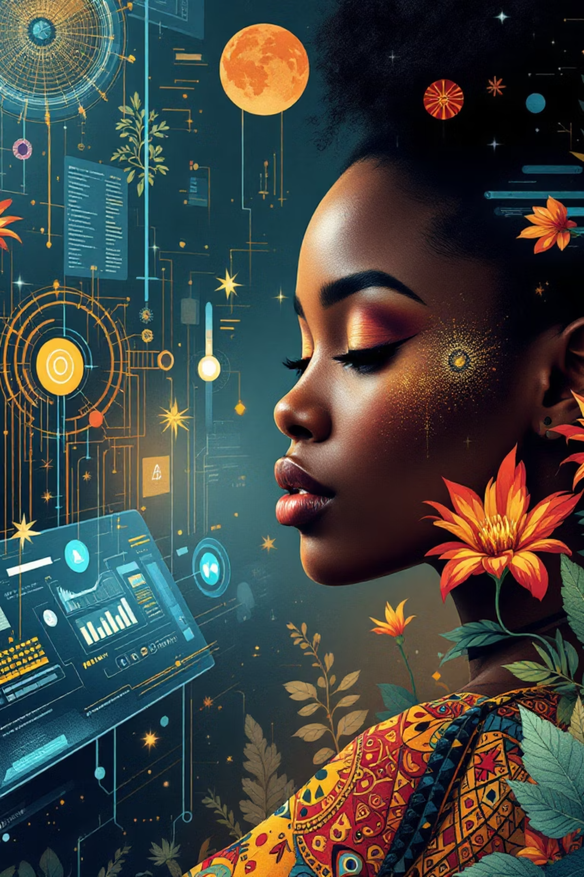
Preserving African Culture through Digital Technology
The Role of Computer Science in Safeguarding Heritage and Promoting Gender Inclusion

Slide 2
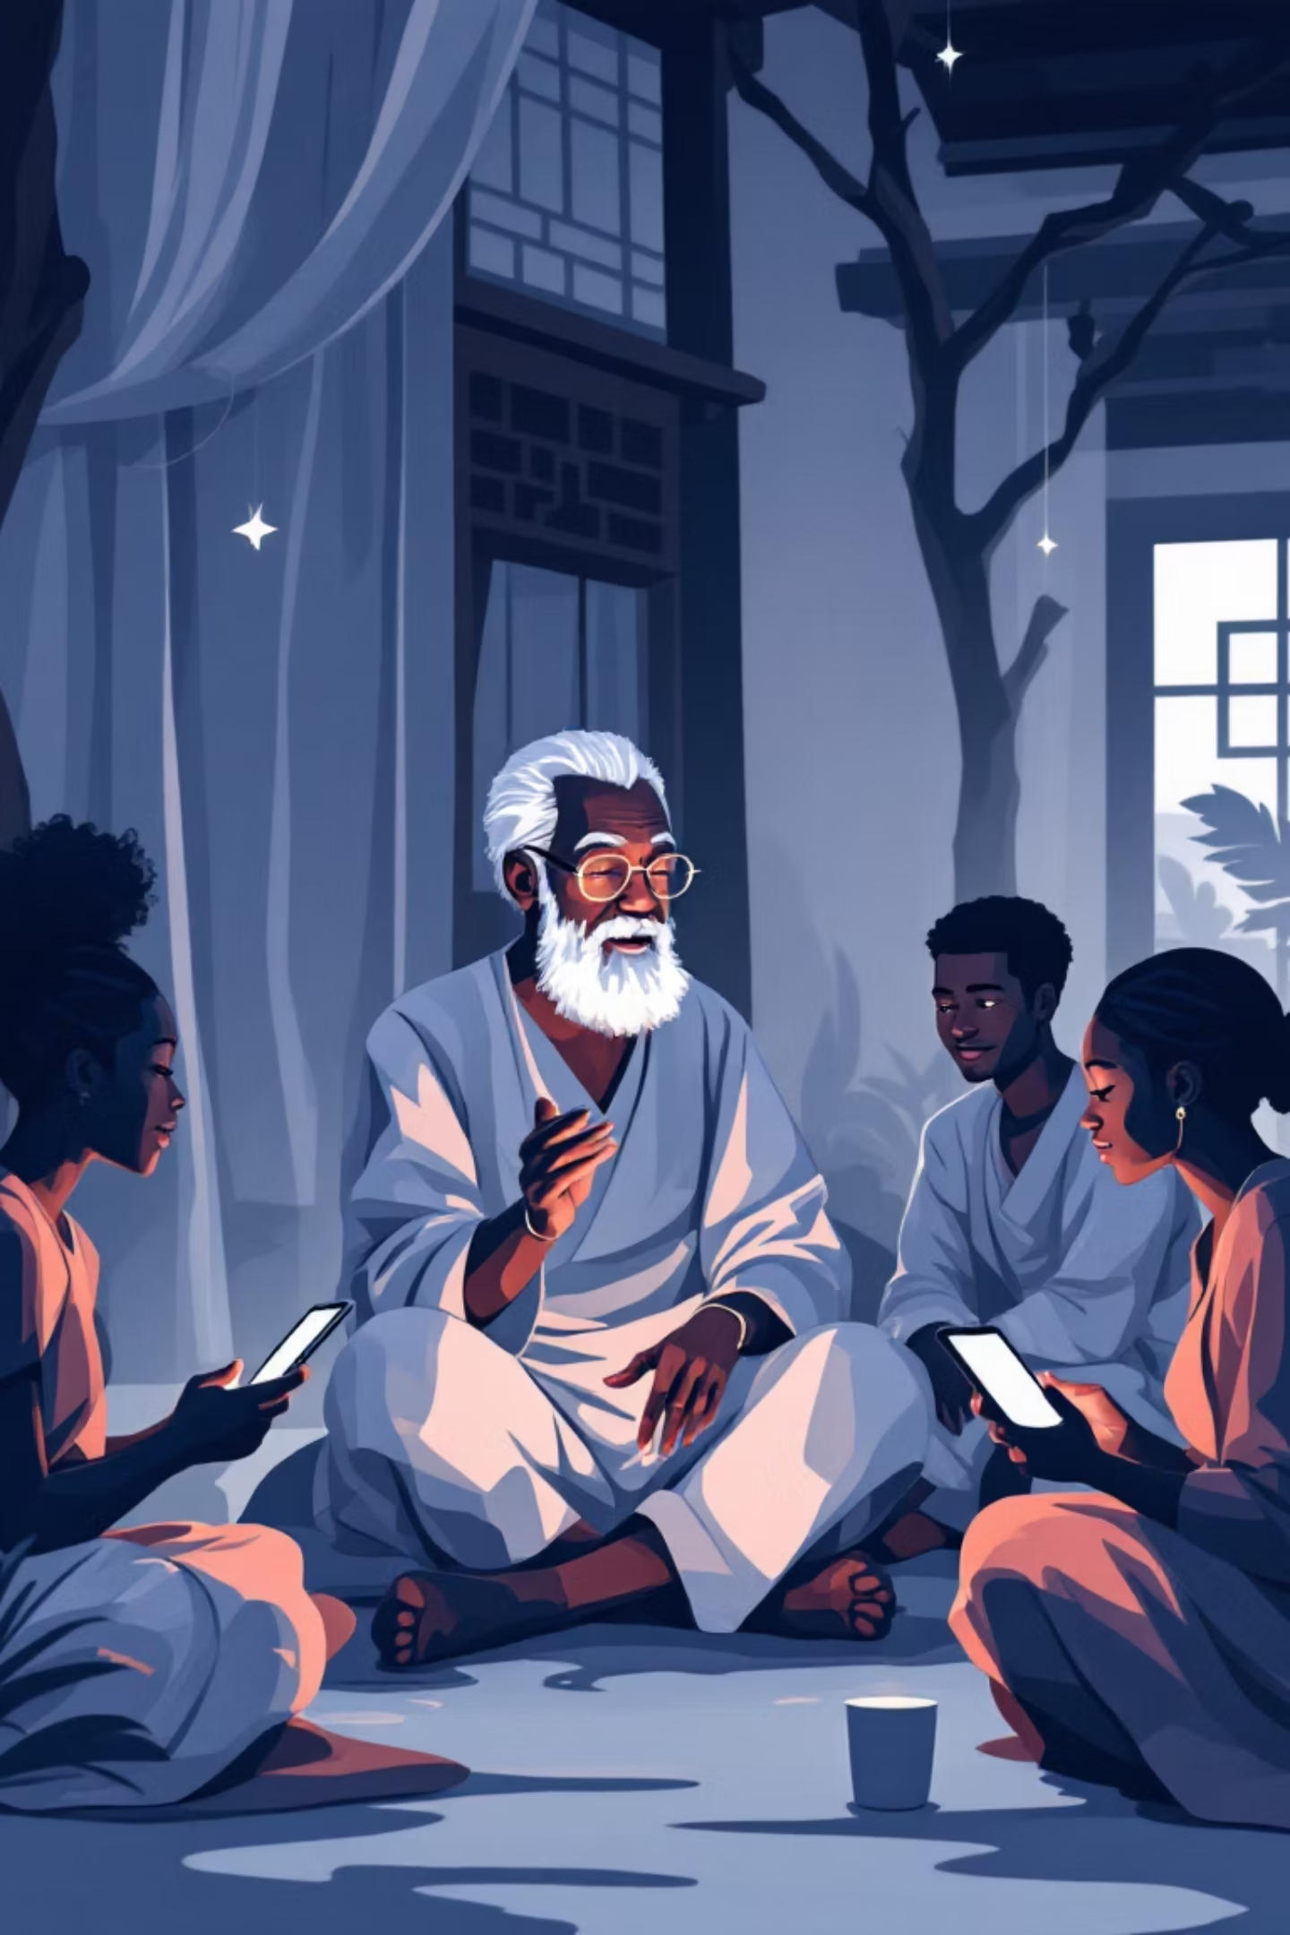
Africa's Rich Cultural Heritage Meets Modern Technology
Cultural Wealth
Digital Opportunity
Africa possesses extraordinary cultural heritage—diverse languages, traditional art, customs, and knowledge systems passed through generations.
Modern technology provides innovative ways to preserve and share this heritage globally, ensuring traditions survive for future generations.

Slide 3





Understanding African Culture
Languages
Arts & Crafts
Thousands of indigenous languages carrying unique worldviews and wisdom
Traditional beadwork, textiles, sculpture, and visual expressions
Oral Traditions
Customs & Beliefs
Stories, songs, and knowledge passed through generations
Cultural practices, rituals, and community values
Technology offers powerful tools to document, store, and promote these traditions to global audiences.

Slide 4
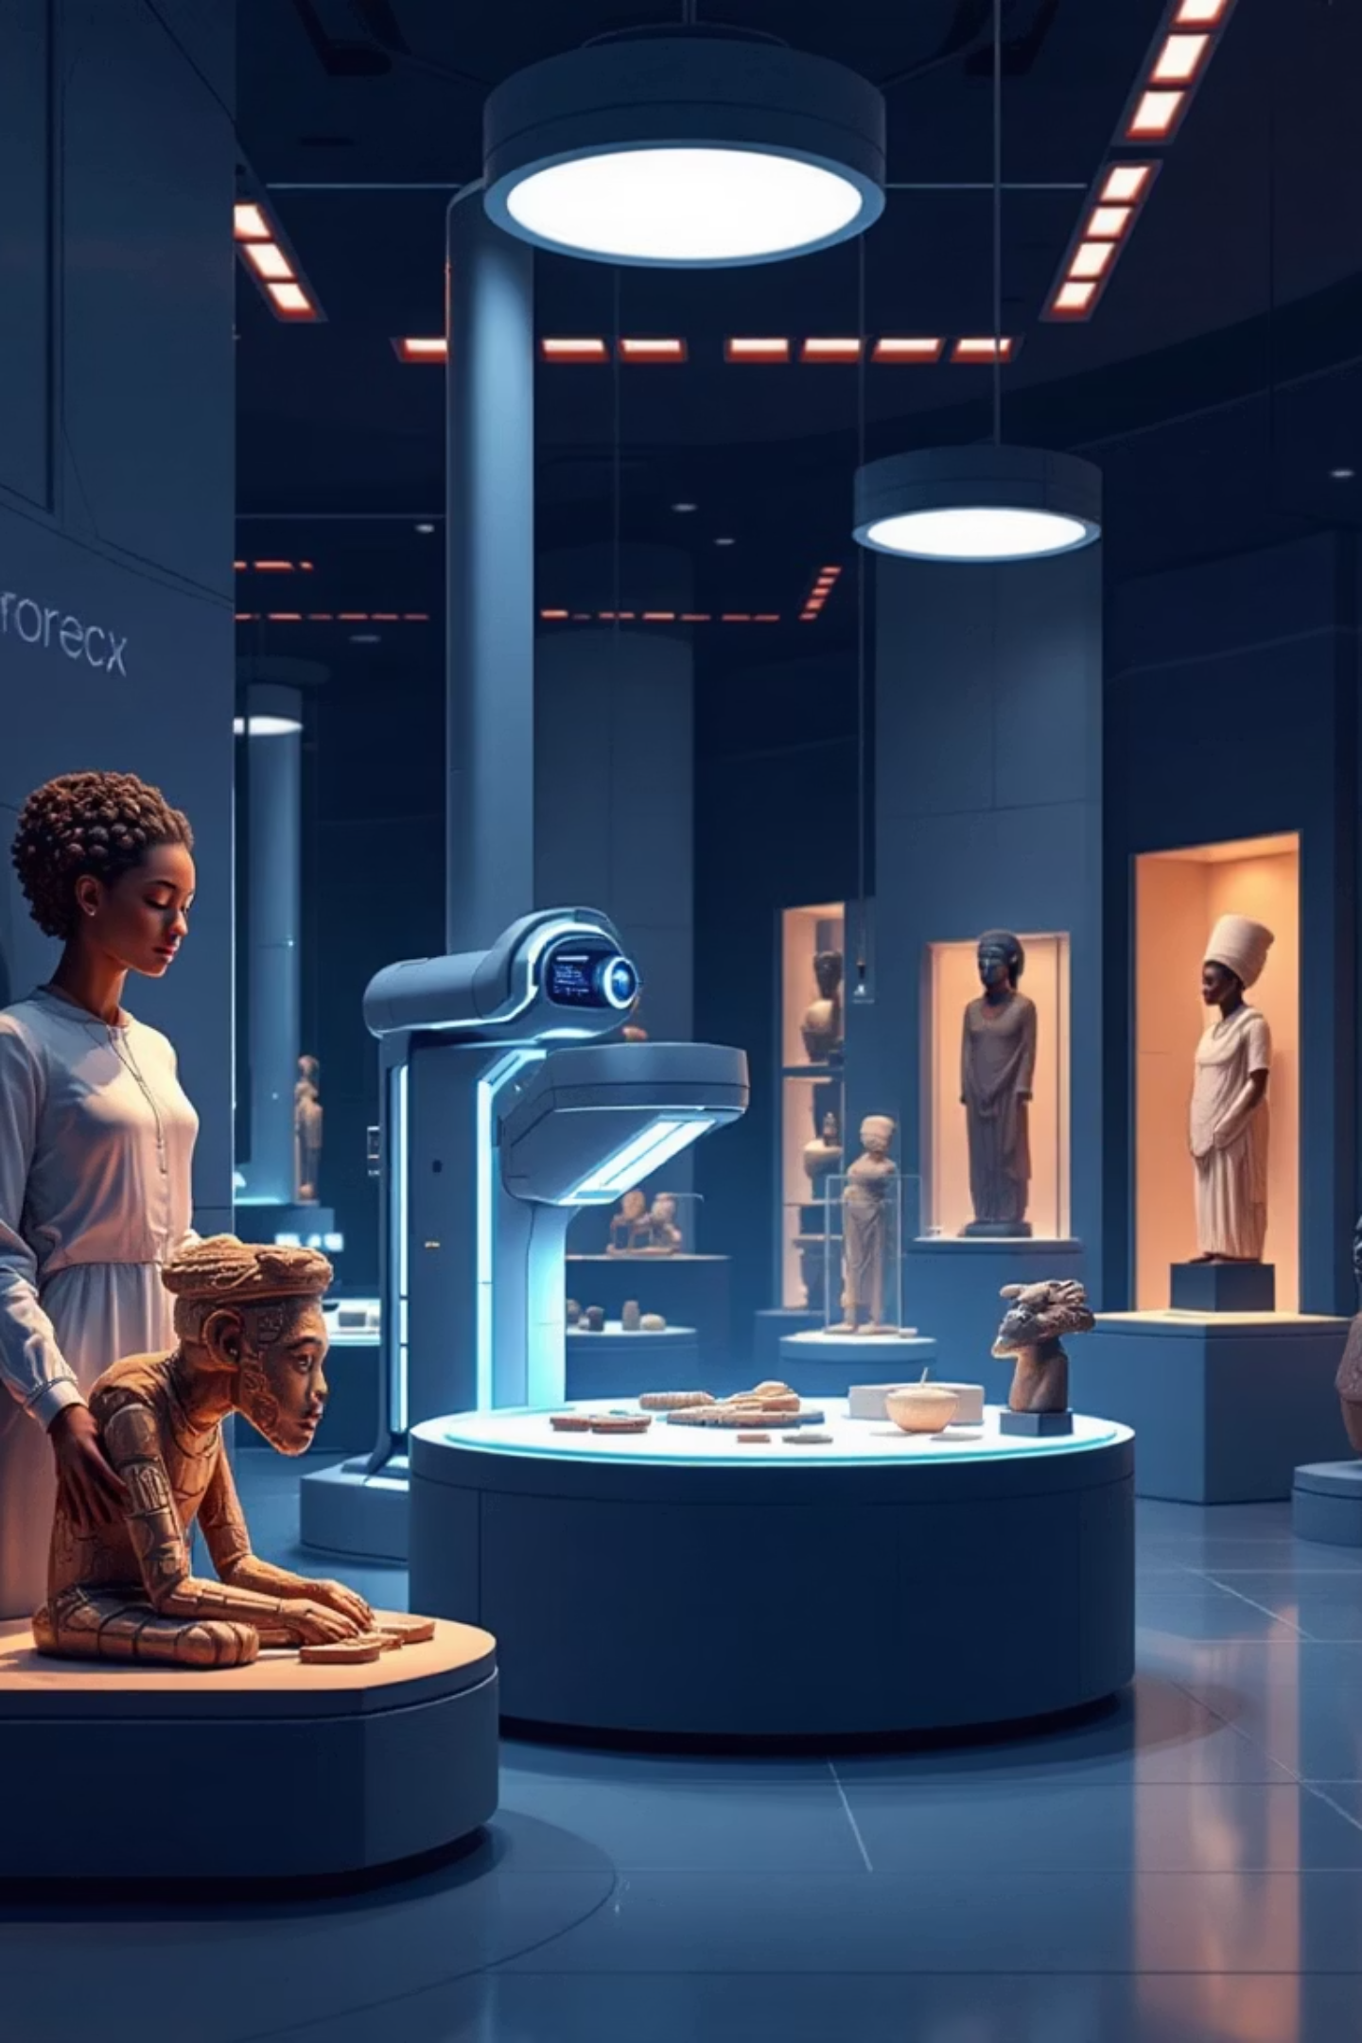

Digital Transformation of African Heritage
01
02
Digitization of Archives
AI-Powered Analysis
Converting physical artifacts, documents, and museum collections into digital formats for preservation and accessibility
Using artificial intelligence for translation, pattern recognition, and cultural data analysis
03
Digital Storytelling
Creating interactive platforms to share oral traditions and cultural narratives worldwide
Success Stories: African Storybook Project and Google Arts & Culture – Africa Collections are leading examples of digital cultural preservation.

Slide 5
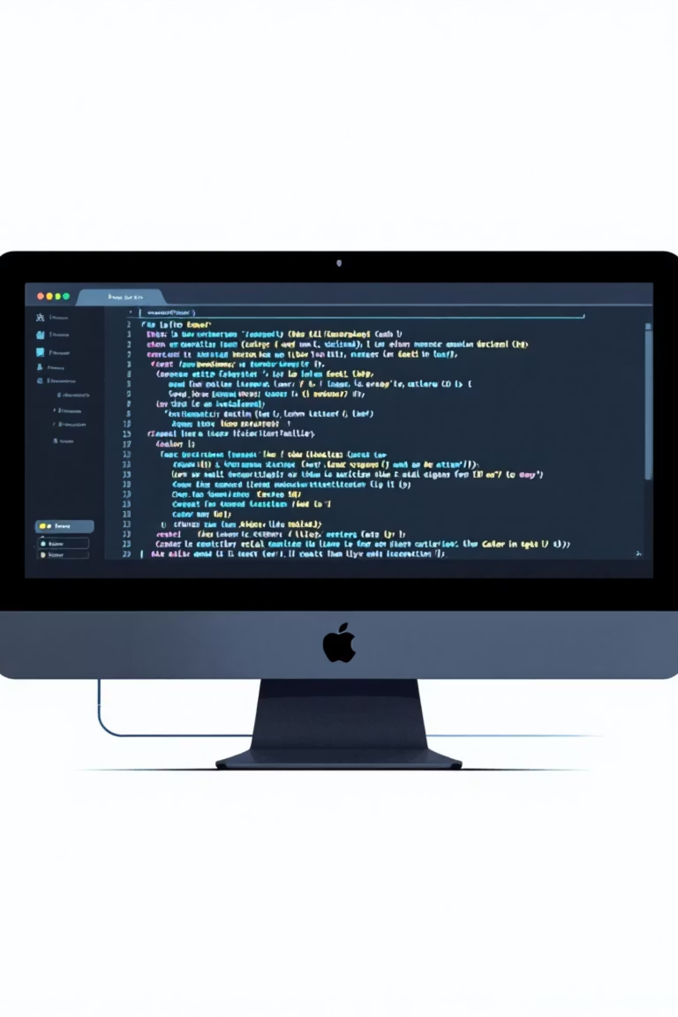
Computer Science: The Technical Foundation
Database Systems
Structured storage and management of cultural artifacts, documents, and multimedia content for long-term preservation
Machine Learning
Advanced algorithms for language translation, pattern recognition, and automated cultural data analysis
App Development
Creating accessible platforms for cultural education, storytelling, and community engagement

Slide 6
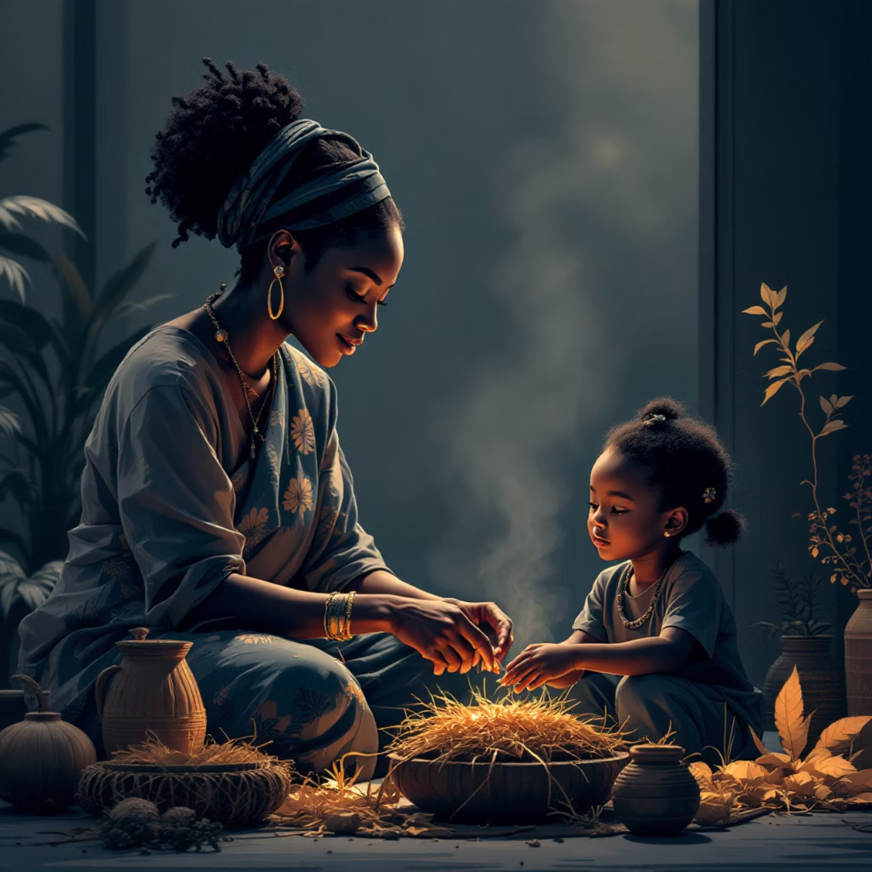
Gender Awareness in Cultural Preservation
Women as Cultural Guardians
Women are key carriers of cultural knowledge—preserving songs, crafts, and oral stories across generations.
Ensuring Balanced Representation
Gender inclusion in digital projects ensures female contributions are documented and celebrated equally.
Empowering Participation
Promoting women's involvement in technology and cultural archiving protects balanced cultural narratives for future generations.

Slide 7
Case Studies: Innovation Across Africa
Kenya
Nigeria
South Africa
Tech projects documenting Kikuyu and Maasai traditions through digital archives and mobile applications
AI-based Yoruba translation projects preserving language and making it accessible to younger generations
Digitization of traditional beadwork and art, creating virtual galleries and educational resources

Slide 8

Challenges to Overcome
Limited Funding
Data Privacy & Ownership
Cultural tech projects often lack sufficient financial resources for development, maintenance, and scaling initiatives.
Complex issues around who owns cultural data, how it's used, and protecting indigenous knowledge rights.
Gender Bias in Tech
Unequal access to technology training and opportunities limits women's participation in digital preservation efforts.

Slide 9
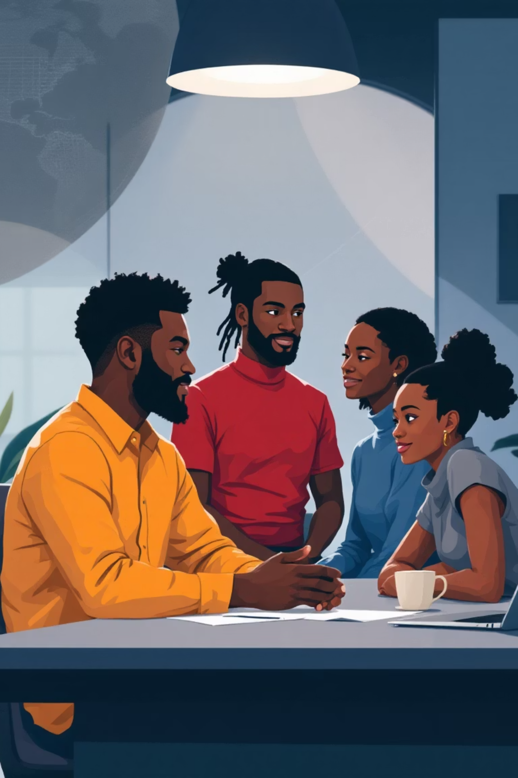



Solutions and Opportunities
Empower Women in Tech
Increase female participation in technology and culture preservation through training and mentorship programs
Strategic Partnerships
Foster collaboration between government, private sector, and cultural institutions for sustainable funding
Open-Source Platforms
Utilize accessible, community-driven technology for African digital heritage projects

Slide 10
Technology Preserves Identity
Cultural Safeguarding
Computer Science Impact
Inclusive Narratives
Technology is vital for preserving Africa's cultural identity in the digital age
Gender awareness ensures cultural stories represent everyone's contributions
CS enables recording, analyzing, and sharing heritage safely and accessibly
References: UNESCO "ICT and African Cultural Heritage" | Google Arts & Culture – African Heritage Project | African Storybook (2023) | African Women in Technology Reports

